Slide 1
Project: The Impact of Different Dropout Rate and Batch Normalization on CIFAR-100
COURSE: CSE465 (PATTERN RECOGNITION)
Section: 3
Submitted by:
Azmine Mahtab Chowdhury (1911517642)
Supervisor:
DR. MOHAMMAD ASHRAFUZZAMAN KHAN
assistant professor
department of electrical and computer engineering
north south university

Slide 2
Project Introduction
Project Focus
3-layer Convolutional Neural Network (CNN) exploration
Impact of dropout rates & batch normalization
Objective
Understand individual & combined effects on performance
Dataset Used
CIFAR-100
Delving into model configurations & insights gathered

Slide 3
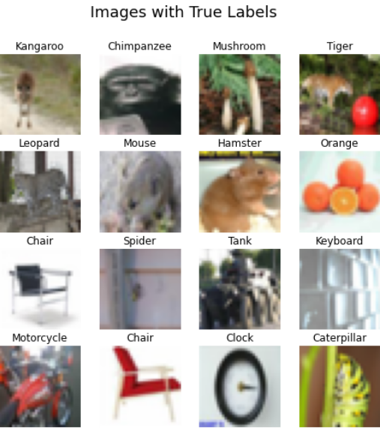
DATASET
STATISTICS
Number of classes | 100
Total Samples | 60000
Number of Sample per class | 600
Number of samples in training set | 40000
Number of samples in test set | 10000
Number of samples in validation set | 10000
Image Dimensions | 32X32X3

Slide 4
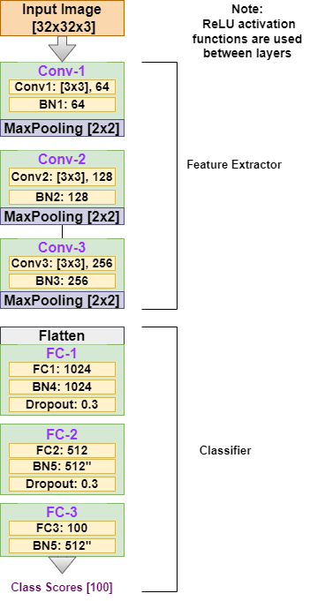
Model Architecture
Input: 32x32x3 image.
Conv Layers:
Conv-1: 3x3, 64 filters + BN.
Conv-2: 3x3, 128 filters + BN.
Conv-3: 3x3, 256 filters + BN.
Pooling: 2x2 MaxPooling after each Conv.
Dense Layers:
FC-1: 1024 neurons + BN + 0.3 Dropout.
FC-2: 512 neurons + BN + 0.3 Dropout.
FC-3: 100 neurons + BN.
Output: Scores for 100 classes.

Slide 5
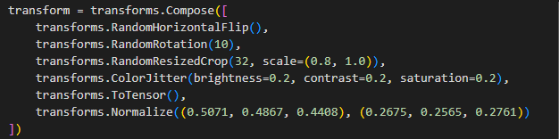
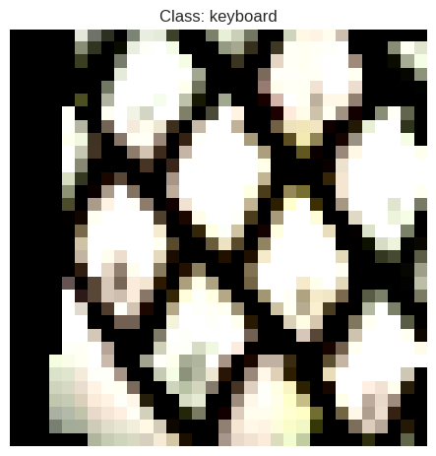
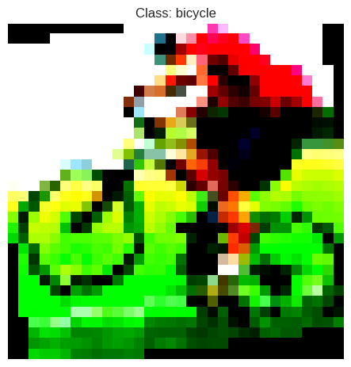
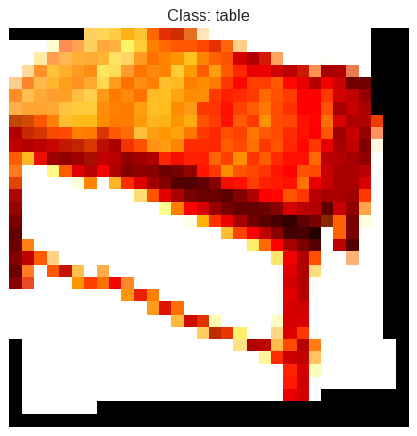
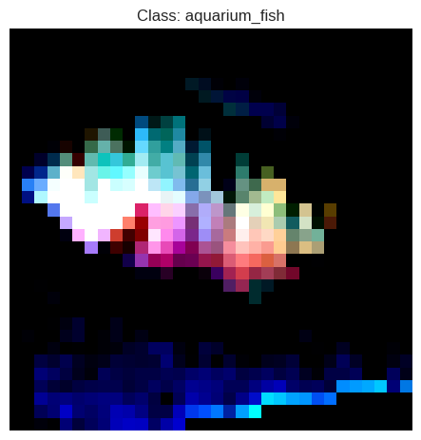
Data preprocessing

Slide 6
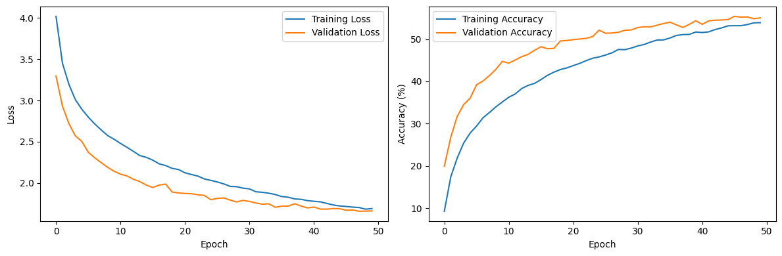
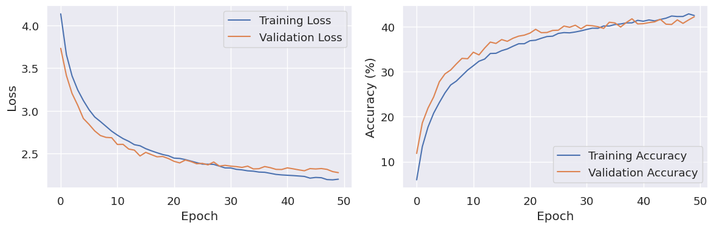
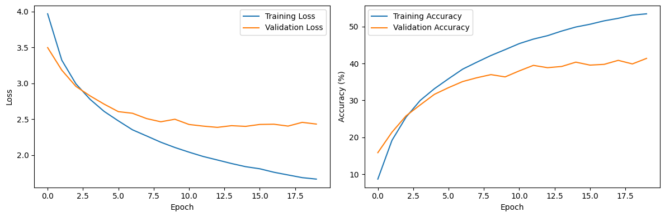
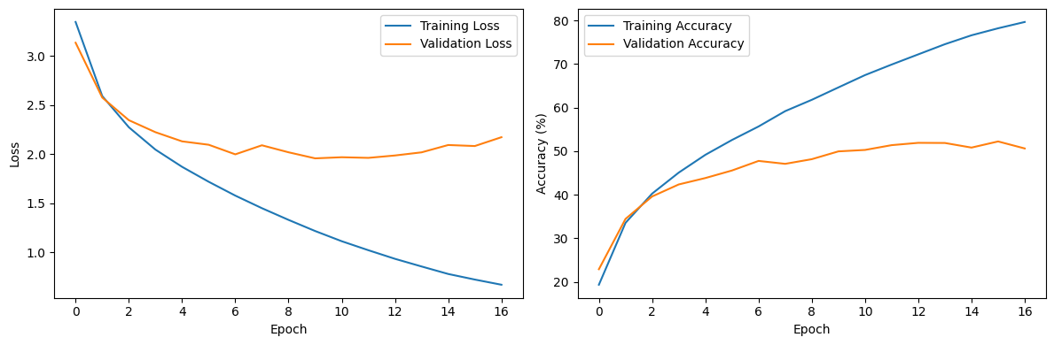
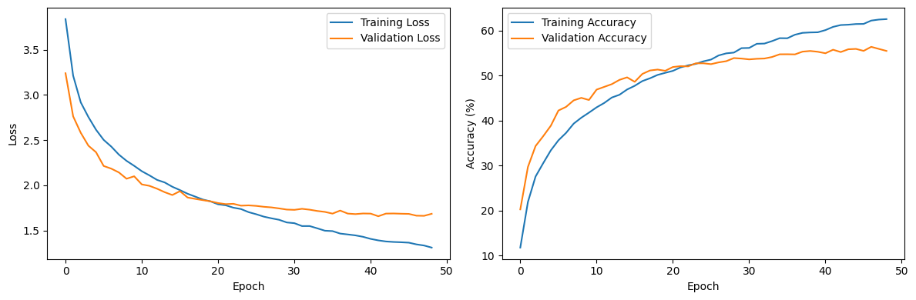
Loss and Accuracy Curve (1)
Dropout0.5_BatchNorm
Dropout0.5_NoBatchNorm
Without Dropout and without BatchNorm
Batch Normalization without dropout
0.3 with Batch Norm

Slide 7
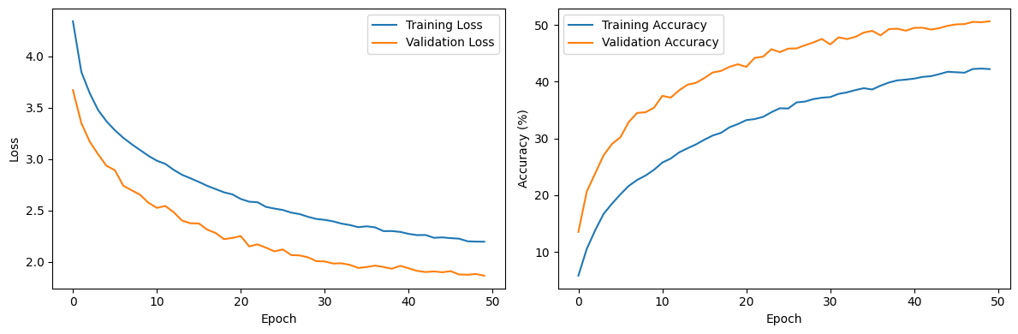
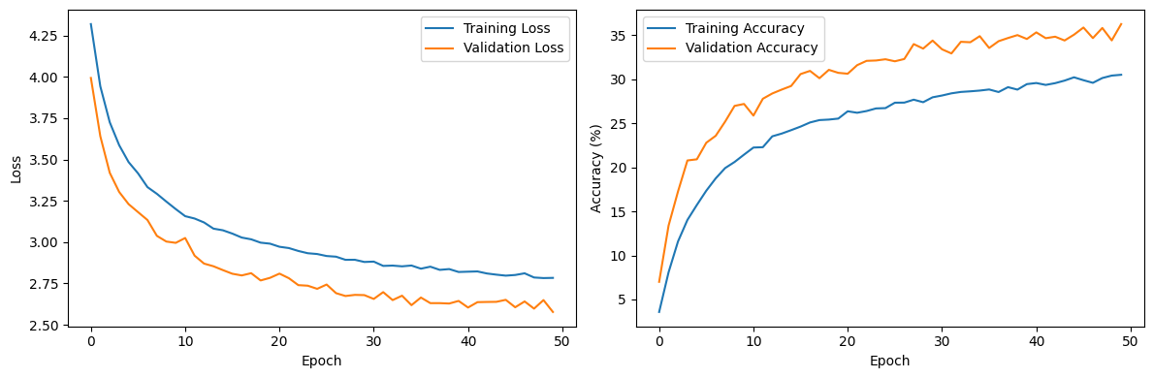
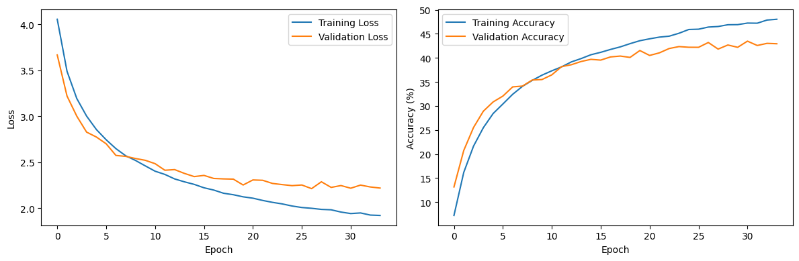
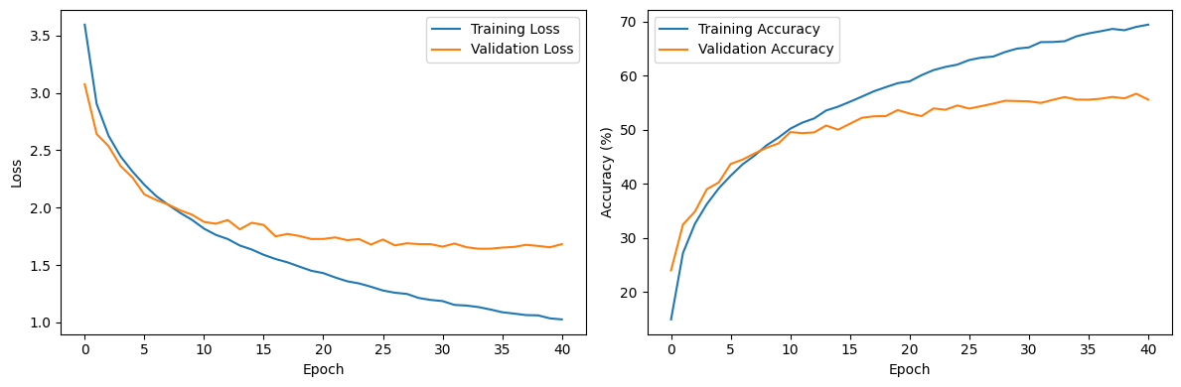
Loss and Accuracy Curve (2)
Dropout0.7_BatchNorm
Dropout0.7_NoBatchNorm
0.5 and 0.3 with batch norm
0.3 Without Batch Norm

Slide 8
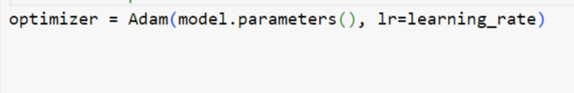
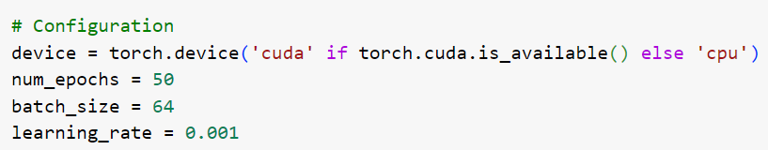
Regularization and optimization and other Hyperparameter
Optimization Method:
- For optimizing the model during training, we've used the Adam optimizer. It's a variant of the popular Adam optimizer that includes L2 weight decay. AdamW helps control overfitting by regularizing model parameters.
Regularization Techniques:
- In the code, we've implemented regularization techniques to enhance model stability. Specifically, we've employed dropout layers in the neural network architecture. Dropout is a technique that prevents overfitting by randomly deactivating a fraction of neurons during training. It encourages the network to learn robust features. We have compared 4 different dropout with and without batch-normalization.:
P = 0.3, 0.5, 0.7
Others:

Slide 9
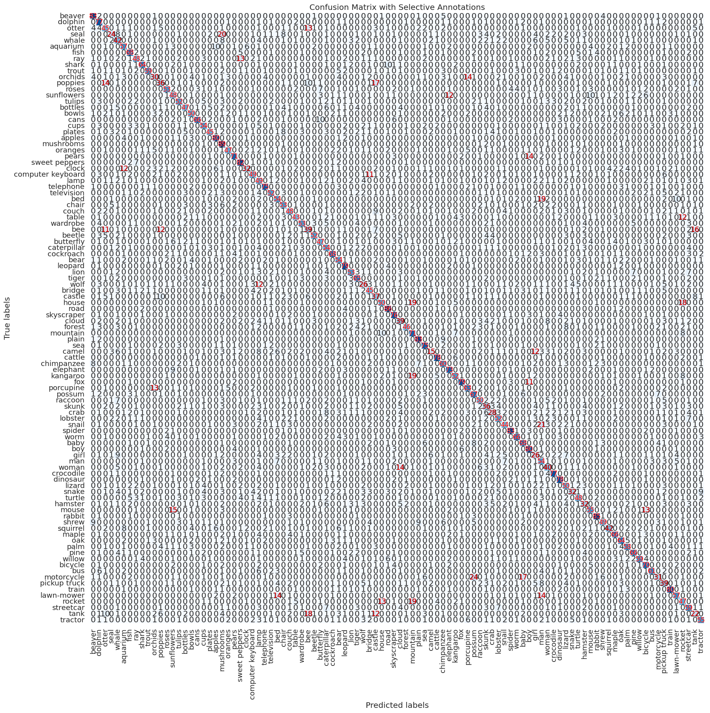
Confusion Matrix (Dropout0.5_BatchNorm)

Slide 10
Confusion Matrix (Dropout0.3_BatchNorm )

Slide 11
Confusion Matrix (Dropout0.7_BatchNorm)

Slide 12
Confusion Matrix (Dropout0.5_NoBatchNorm)

Slide 13
Confusion Matrix (Dropout0.3_NoBatchNorm)

Slide 14
Confusion Matrix (Dropout0.7_NoBatchNorm)

Slide 15
Confusion Matrix (Only_BatchNorm )

Slide 16
Confusion Matrix (NoDrop_NoBatchNorm )

Slide 17
Confusion Matrix (Dropout0.5_0.3_BatchNorm)

Slide 18
Result
Configuation | Accuracy | Precision | Recall | F-Score
Dropout-0.5 BatchNorm | 0.56 | 0.56 | 0.56 | 0.55
Dropout-0.3 BatchNorm | 0.57 | 0.58 | 0.57 | 0.57
Dropopout-0. 7 BatchNorm | 0.51 | 0.52 | 0.51 | 0.5
Dropopout0.5 NoBatchNorm | 0.43 | 0.44 | 0.43 | 0.42
Dropout-0.3 NoBatchNorm | 0.43 | 0.44 | 0.43 | 0.42
Dropout-0. 7 NoBatchNorm | 0.36 | 0.38 | 0.36 | 0.35
Only BatchNorm | 0.52 | 0.53 | 0.52 | 0.52
NoDropout NoBatchNorm | 0.41 | 0.42 | 0.41 | 0.41
Dropout-0.5,0.3 BatchNorm | 0.57 | 0.57 | 0.57 | 0.56

Slide 19
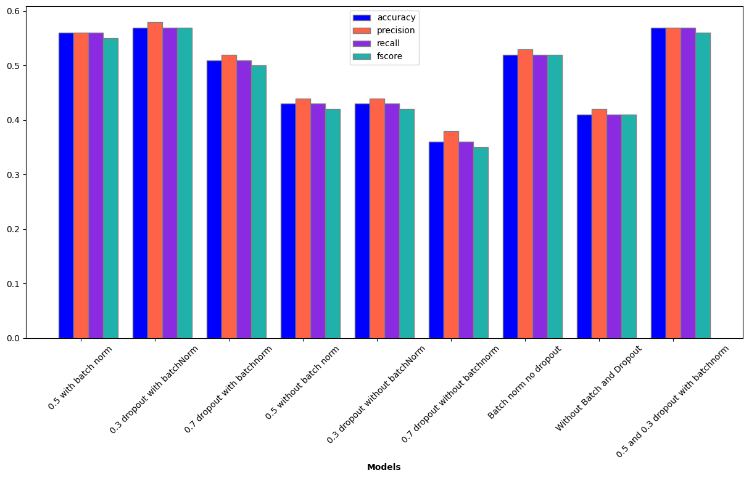
Result

Slide 20
Thanks

